Slide 1

Making 4-H Event Councils Effective
Webinar II- February 26, 2020
Notes:
Amy

Slide 2
Objectives
Understand 4-H Council Finances​
Learn ways to make 4-H Events Council more effective ​
Learn new ways for engaging council members as they represent their club and help advance 4-H youth development program outcomes through educational events​
Respond to feedback and questions
Notes:
Amy

Slide 3
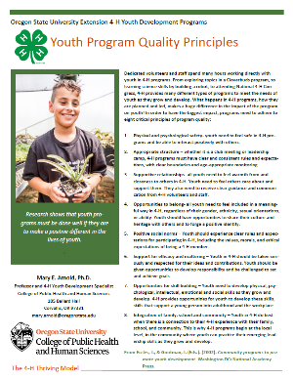
Youth Program Quality Principles
4-H Thriving Model
Dr. Mary Arnold
Youth Program Quality Principles
Notes:
Diane

Slide 4
Youth Program Quality Principle
Opportunities For Skill Building
"My most meaningful leadership role in 4-H is being president of our county council. This is a very honorable position. I am able to be seen as a leader to my county, club, and peers around me."
  16 year old KYLF Delegate
  Community Vitality Survey
Notes:
Diane

Slide 5
Youth Program Quality Principle
Integration of Family, School and Community
"I have used my 4-H leadership skills outside of 4-H by leading in my local FFA Chapter and District FFA officer team. Without 4-H, I would not be able to have all the leadership experience that I have now. 4-H has helped teach me many life skills that I will use the rest of my life. Since I have been little, 4-H has made a positive impact on my life, and has helped shape me into the Leader that I am today!"
16 year old KYLF Delegate
Community Vitality Survey
Notes:
Diane

Slide 6
Finances
Principles of Managing Funds for Extension Affiliated Groups
Principle #1 Accountability for all Funds/Accounts
Principle #2 Two Signatures Required
Principle #3 Receipt all Financial Transactions
Principle #4 4‐H Accounts and the IRS
Principle #5 Financial Reviews
Notes:
Beth
Before we start....With 105 local offices, there are a number of unique situations with local 4-H Event Council Finances. We will take a few general questions at the end of this section, but specific situations should be discussed with your Regional Specialist. If there are some general kinds of questions you can send those to me to be addressed in our 4H Events Council Q & A Webinar session that we mentioned on last times webinar.
Principles of Managing Funds for Extension Affiliated Groups
4-H Clubs/Groups, Master Gardeners and other groups under the jurisdiction of K-State Research and Extension who receive and dispense funds, including donations, registration fees, etc. must follow the principles of Managing Funds for Extension Affiliated Groups.
Extension Boards/Governing Bodies are not to manage the funds of FCE groups, livestock marketing groups, and marketing clubs.
Junior livestock auction sales monies are to be managed by the Fair Association/Board or a committee/third party so designated by the Fair Association/Board rather than the Extension Board or one of its affiliated groups.
Principle #1: Accountability for all Funds/Accounts
All accounts and all expenditures of funds of the Local Extension Unit, from whatever source derived, are subject to approval of the Extension Board and the Director of K‐State Research and Extension. The Director and local Extension Boards are accountable for all funds generated for Extension programs. This includes all funds collected/raised in the name of Extension 4‐H Programs including clubs and other Extension affiliated groups.
Principle #2: Two Signatures Required
While banks do not require this practice, for Extension financial management practices, all accounts should require two signatures for writing checks. Extension employees may not be signatory on any fund accounts. Those that are signatory on accounts should not be family members.
Principle #3: Receipt all Financial Transactions
All funds should be receipted each time they change hands (i.e. at time of collection from payee, from the financial institution upon deposit, between any individuals to whom funds are transferred). Receipts should be available on request.
Principle #4: 4‐H Accounts and the IRS
All Extension affiliated entities with financial account(s) must have their own employer identification number from the Internal Revenue Service. All 4‐H Club/Group(s) accounts must be included in the data base of approved clubs/groups/organizations maintained by the Kansas State University Department of 4‐H Youth Development.
Principle #5: Financial Reviews
All local Extension affiliated groups, including 4‐H Clubs/Groups, are included in the tax reporting authority of local Extension Boards and must have their financial records reviewed annually by the local Extension Board. The local extension unit board should approve the review form and note in the minutes the name of the club/group of each approved financial review report.
4-H Clubs/Groups not listed in the 4-H departmental database and not undergoing an annual financial review by the local extension board — or any other account not in compliance with this principle:
• will not be considered a formally authorized club/group/affiliate
• will not be considered a charitable organization according to the IRS
• cannot accept donations as tax-deductible
• will be subject to reconsideration of the privilege of using the 4-H name and emblem as decided by the State 4-H Program Leader
• will be responsible for registering and reporting as specified by the IRS as a “for-profit” business, subject to all associated tax filing and reporting responsibilities

Slide 7
Finances
Management:
Active PARTNERSHIP with the local office
Accounting software or plan
Paying bills between meetings
Managing multiple funds within 4-H Events Council Account(s)
Notes:
Beth
How to Manage:
Through an ACTIVE Partnership with Local Office Because of the large volume of transactions, large balances and number of unit wide funds this is often a partnership with staff in the local office and the 4-H Council Treasurer to keep an accurate account of any money that may be the property of the 4-H Council, pay bills approved by the Council and prepare reports for each council meeting of the account.
This needs to be an active partnership where both parties are involved and know what is going on
Accounting software or plan
Paying bills between meetings
If the items is on an approved budget it is appropriate to pay
Ask creditors to change due dates when applicable
Make decisions ahead of time
Can officers make decision?
Managing multiple finds within 4-H Council

Slide 8
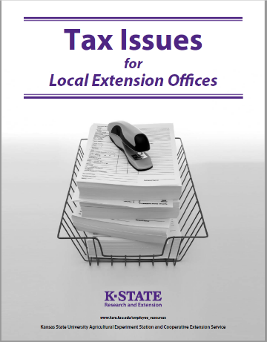
Finances
Fundraising
Tax Exempt Status
Sales Tax Exemption
Raffles
https://www.kansas4-h.org/resources/4-h-library/4-h-clubs/club-finances/index.html
Notes:
Beth

Slide 9

Finances
Setting a budget each year does several things:
With appropriate information, it allows for data driven decisions
Maps the financial plan for the year giving committees goals and boundaries
Helps members learn an important life skills
Notes:
Beth
1) With appropriate information, it allows the members to make data driven decisions
Software or set up
Proposed and actual data over the years
2) Maps the financial plan for the year giving committees goals and boundaries
Tells the group where money will be spent, allows for budgeted items to be paid between meetings when necessary
3) Helps member learn an important life skill
We all know budgeting is a skill more people need to understand and learning to stay within a budget is as well.

Slide 10
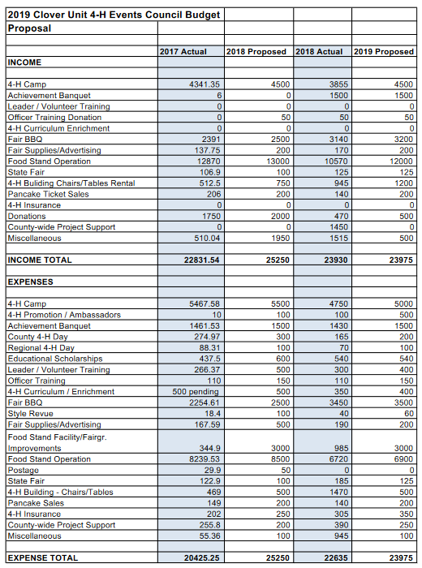
Finances
Sample budget
Notes:
Beth
Allow time for questions

Slide 11
Poll 1
How many total members make up your local 4-H Events Council?
Less than 10
10 to 20
21 to 30
31 to 40
41 to 50
Over 50
Notes:
Amy

Slide 12
Poll 2
On average, what percentage of your total council membership attends meetings?
Less than 50%
50%
75%
90% or more
Notes:
Amy

Slide 13

Diagnosing the Situation
Take a moment to think about your local 4-H Events Council
Social Environment: Who is doing the talking? Youth or Adults?
Physical Environment: Is the size of room suitable for the number of meeting participants? Room arrangement? How are the acoustics?
What changes need to occur to engage members?
Notes:
Diane

Slide 14
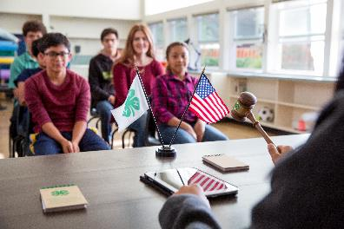
Engaging Members
Guidelines for Producing a Climate of Trust
Youth Program Quality Principle:
Supportive Relationships & Appropriate structure
Accept Others
Speak for Yourself
Avoid Put-Downs
It's Okay to Pass
You Are Responsible
Expect Unfinished Business
(Resource: LEADS Unit III, Module, 1 page 9)
Notes:
Diane

Slide 15
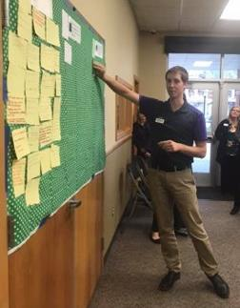
Engaging Members
Youth Program Quality Principles:
Supportive relationships & Appropriate structure
Small group discussion, call on youth to share
Are all ideas presented given consideration? Sticky wall
Notes:
Beth
As we think about ways to engage members, you will want to have a conversation with your council president and officers about ways to involve the group, and checking in on progress in that area.
Two methods that might work for engagement around an issue are small groups discussions and the sticky wall.

Slide 16
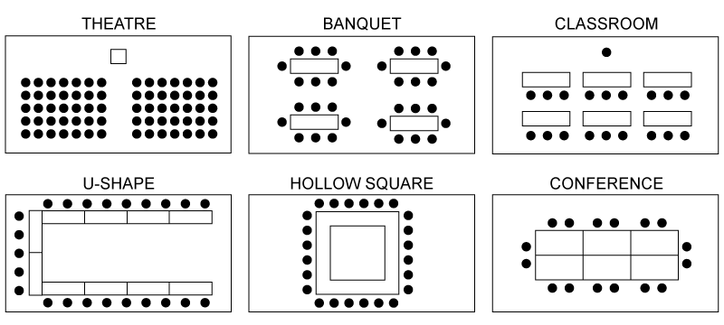
Room Set Up
MULTIPLE TABLES (Round or Rectangle)
Notes:
Amy

Slide 17
Poll 3: What room set up are you currently using?
Theatre
Round Table
Classroom
U-Shape
Hollow Square
Conference
Other
Notes:
Amy

Slide 18
Room Set Up | Advantages | Disadvantages
U Shape | Convenient for 6 to 20 people Easy for leader to have eye contact with all | Discourages small group team building Reduces getting to know other people Limits movement of the leader
Classroom/ Theatre | Allows for many people Leader is clearly in charge | Encourages one-way communication Encourages side-bar conversations Hard to hear in the back of the room
Hollow Square | Hard to select leadership position Good morale for people | Hard to select leadership position
Conference | Leader can assert control in front of room | Limits number of people to size of tables Encourages discussion
Multiple tables | Encourages discussion Encourages small group team building | Hard to select leadership position Encourages side bar conversations Some will have their back to the front of the room
Supportive relationships Appropriate structure
Notes:
Diane

Slide 19
Room Set Up
MULTIPLE TABLES (Round or Rectangle)
Notes:
Amy

Slide 20
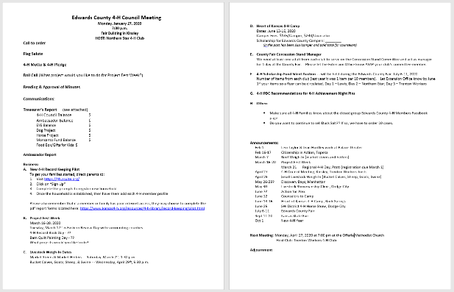
Sample Agendas
Notes:
Amy

Slide 21
Components of Orientation
Understanding the Council Rep. Position Description
Council Organization and Function
  Members/Voting
  Meeting Schedule
  Committees
Budget
Notes:
Beth
Orientation is important to go over every year, with EVERYONE. As even people that have been on council sometimes lose site of the functions and their responsibilities.
Understanding the Council Rep. Position Description
It is important that members understand who they represent, and what their responsibilities are as a council member. We discussed these in our first webinar.
Council Organization and Function Members/Voting
Meeting Schedule
Committees
Budget

Slide 22
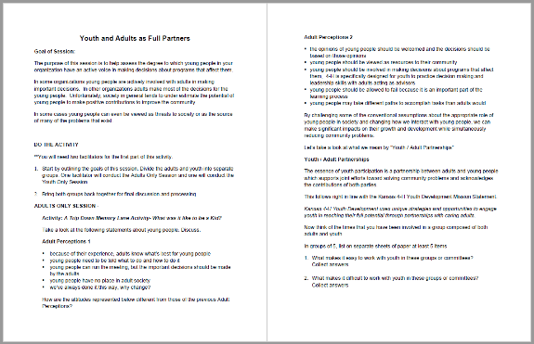
Youth Adult Partnership Resource
Notes:
Diane

Slide 23
Webinar Feedback
Please take a moment to complete the following survey:
4-H Events Council Webinar Feeback Qualtrics Survey
Resources to share? Sample Committees, By-Laws, Budgets, etc.
Send to your Regional Specialist.
4-H Events Council Q & A Webinar
9:15 am, March 10, 2020 via Zoom
Notes:
Diane Feed back survey
Amy

Slide 24
Previous Webinar Series
County Fair Series
Officer Training Series
Thank you.

